Slide 1


Leading Categories Powering
Social Buzz

Slide 2


Today's agenda
Project recap
Problem
The Analytics team
Process
Insights
Summary

Slide 3

Client: Social Buzz
Industry: Social Media and content creation.
Project Duration: 3 Months
Project Deliverables:
An Audit of Client’s Data
Recommendations for IPO
Analyzing Top 5 most popular categories.
Project Recap

Slide 4


Problem
100000 posts per day!
Over 36.5 million pieces of content per year!!
Way Out?
To filter out Top 5 Categories of Content

Slide 5



Andrew Fleming
Chief Technology Architect
The Analytics team
Marcus Rompton
Senior Principal
Nevil Mehta
Data Analyst

Slide 6
Process
1
Data Understanding
2
Data Cleaning
3
Data Modeling
4
Data Analysis
5
Uncovering Insights

Slide 7
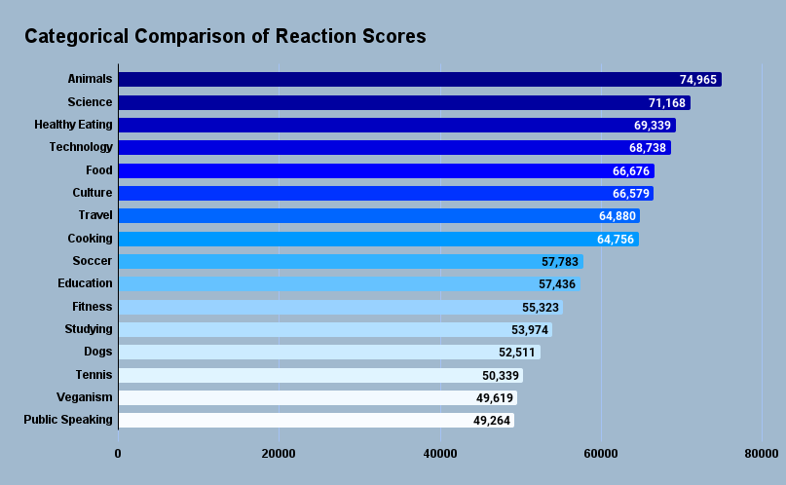
Ranking Content Categories based on Reaction Scores

Slide 8
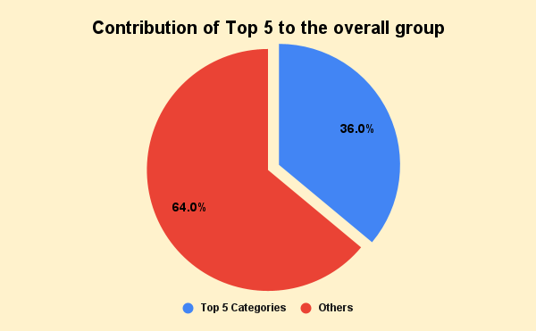
Overall Categorical Distribution of Reaction Scores

Slide 9
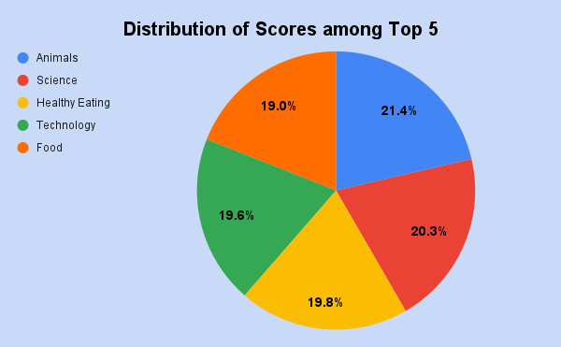
Analyzing Scores Distribution within the Top 5

Slide 10
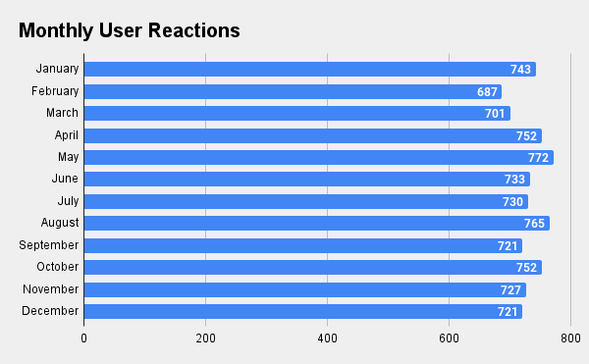
Monthly distribution of User Reactions among the Top 5

Slide 11
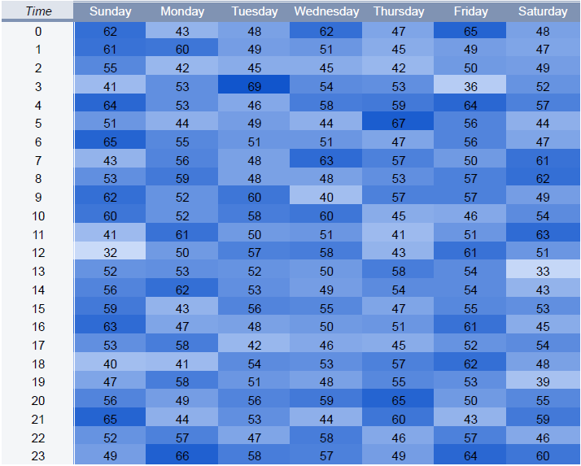
Heatmap of User Reactions by Time and Day

Slide 12
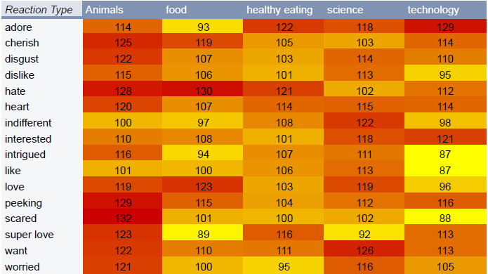
Heatmap of User Reactions by Reaction Type

Slide 13
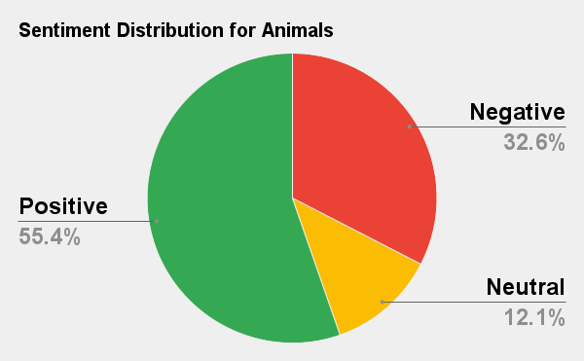

Sentiment Analysis of Top 5 Categories

Slide 14
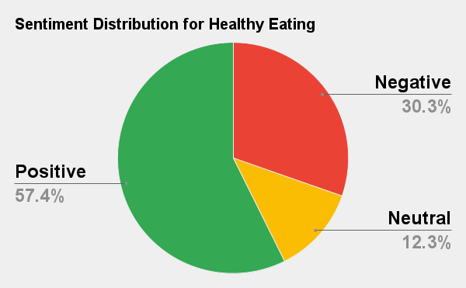
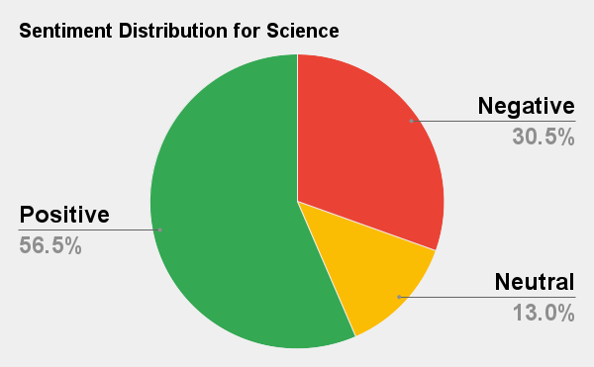
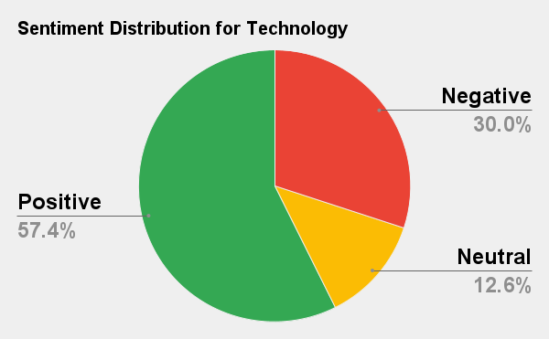

Slide 15
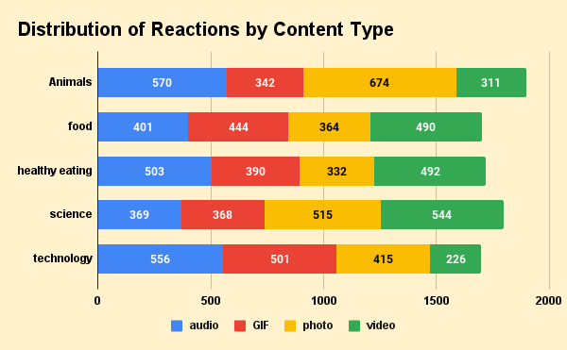
Content Type Breakdown of Reactions

Slide 16
Insights
Overall 16 unique categories
Top 5 categories: Animals, Science, Healthy Eating, Technology, Food
Highest Sentimental Score : Animals (74,965)
Month with most reactions: May
Day with most reactions : Sunday
Time : 3 AM - 6 AM and 8 PM - 12 AM
Top Reaction Types : Adore, Hate, Want
Average of 55% likeness and 30% hatred observed

Slide 17


Top 5 categories identified and insights gained.
Average of 30% hatred observed.
Reaction Types: Scared, Worried, Hate.
Reaction peak time: Early Morning, Late Night.
Most Popular Category was Animal followed by Food (Healthy eating)
Indicates Users are more of nature lovers and health conscious.
Suggestion: Feeding content related to healthy eating and animals in the form of photos during these hours.
Summary

Slide 18

Thank you!
ANY QUESTIONS?

